Slide 1
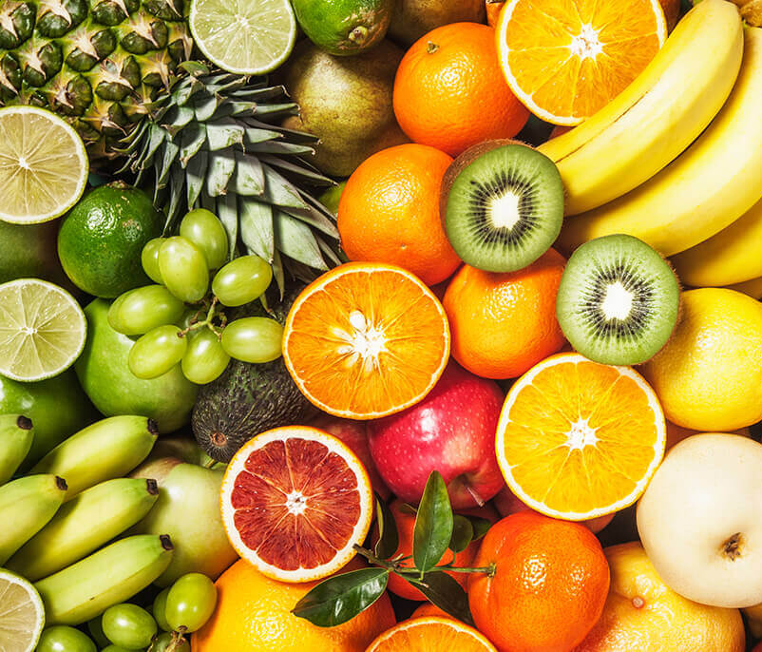

Robotic Sorting System Project Update Presentation Pace Dominy, Joseph Miller, Lam Tran

Slide 2
Project Description
The Robotic Sorting System is an automatic sorting system that requires limited manpower/oversight that can accurately sort fruit by their size and quality without the user having to do it themselves.
Notes:
Sorting fruit by hand can be tedious and expensive
The Robotic Sorting System provides a relatively inexpensive way to accomplish the task
It optically scans the fruit to determine its size and color
Then puts it in a bin as specified by the machine configuration
It’s particularly useful for cost-limited or near-end-user applications where you don’t want/can’t afford something huge and expensive.

Slide 3
System Diagram
Maroon arrows denote physical inputs and outputs
Operator Input
Fruits
Android Application
System Status
Conveyor Belt
Joseph Miller
Sorting Configuration
Control
Sensors
Data
Raspberry Pi
Fruits
Data
Robotic Levers
Fruit Receptacles
Lam Tran
Power Control
Provides power to all subsystems except Android application
Pace Dominy
Pace Dominy
Wall Power
Notes:
All configuration and system status is displayed via an Android application
The sensors and Android app connect to a Raspberry Pi that pushes configuration to the robotic levers
Wall power is standard U.S. 120V 60Hz mains power

Slide 4
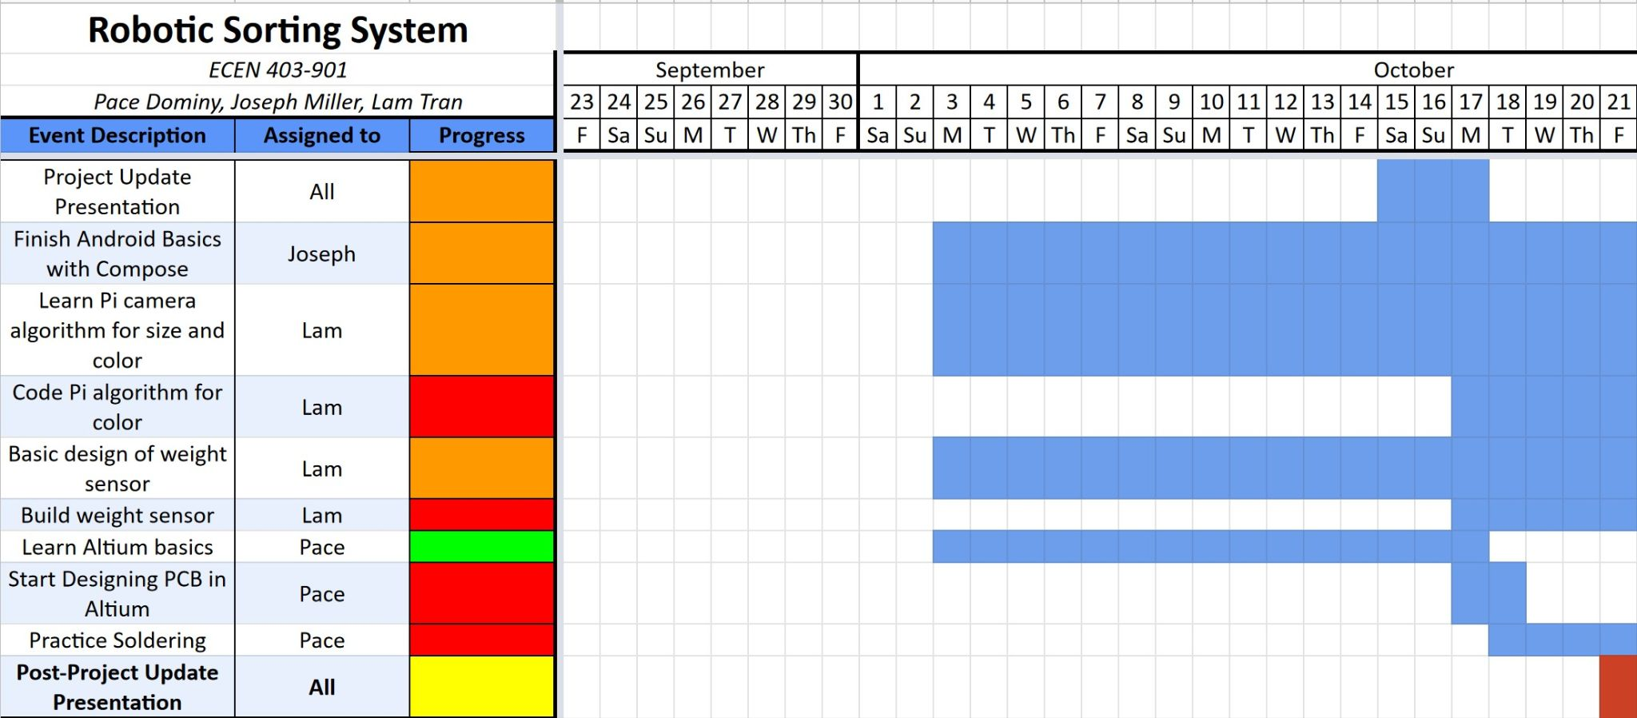
Schedule: Recent Progress
Notes:
This is our design work so far
From a high-level view, we’ve mostly been doing a blend of research and design
This includes a bit of schedule reworking as we get a better understanding of how long these things really take
Recent progress has been much more on the design side: getting ready to physically build our subsystems
More will come in each subsystem update

Slide 5
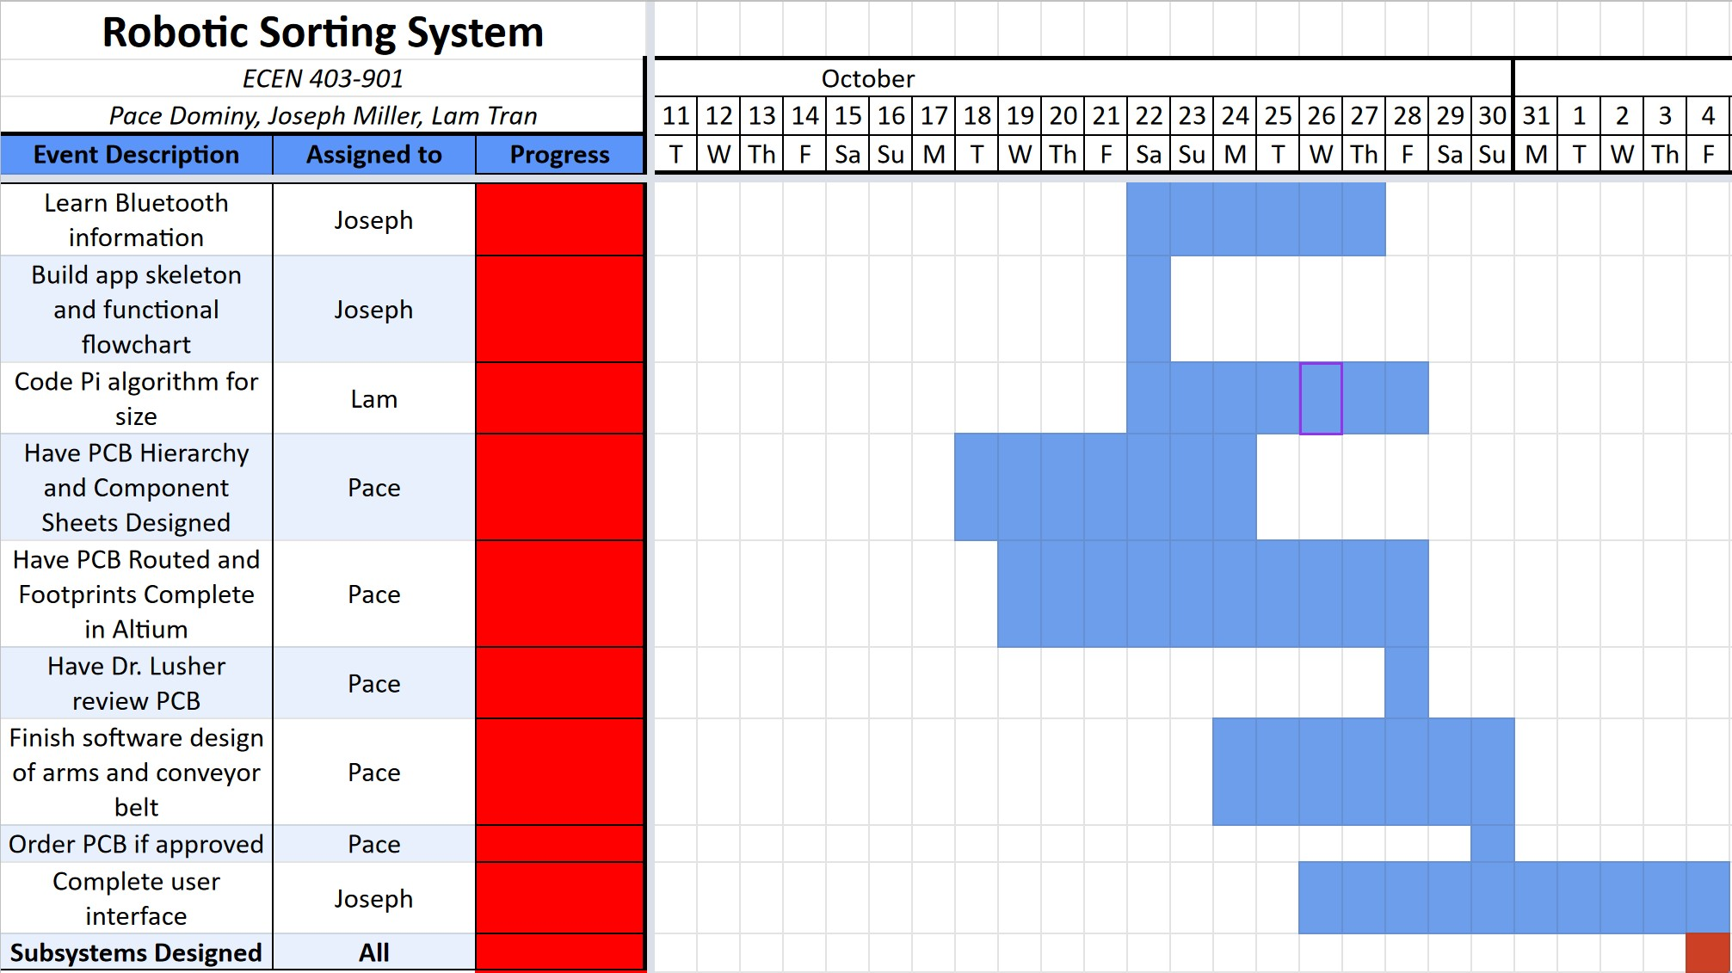
Schedule: Looking Forward
Notes:
Our immediate focus going forward is to finish the design of our subsystems
This includes, for the physical things, figuring out what’s going to be connected, how, and where
For the software side, this includes learning how to work with specific protocols and finishing learning the language

Slide 6
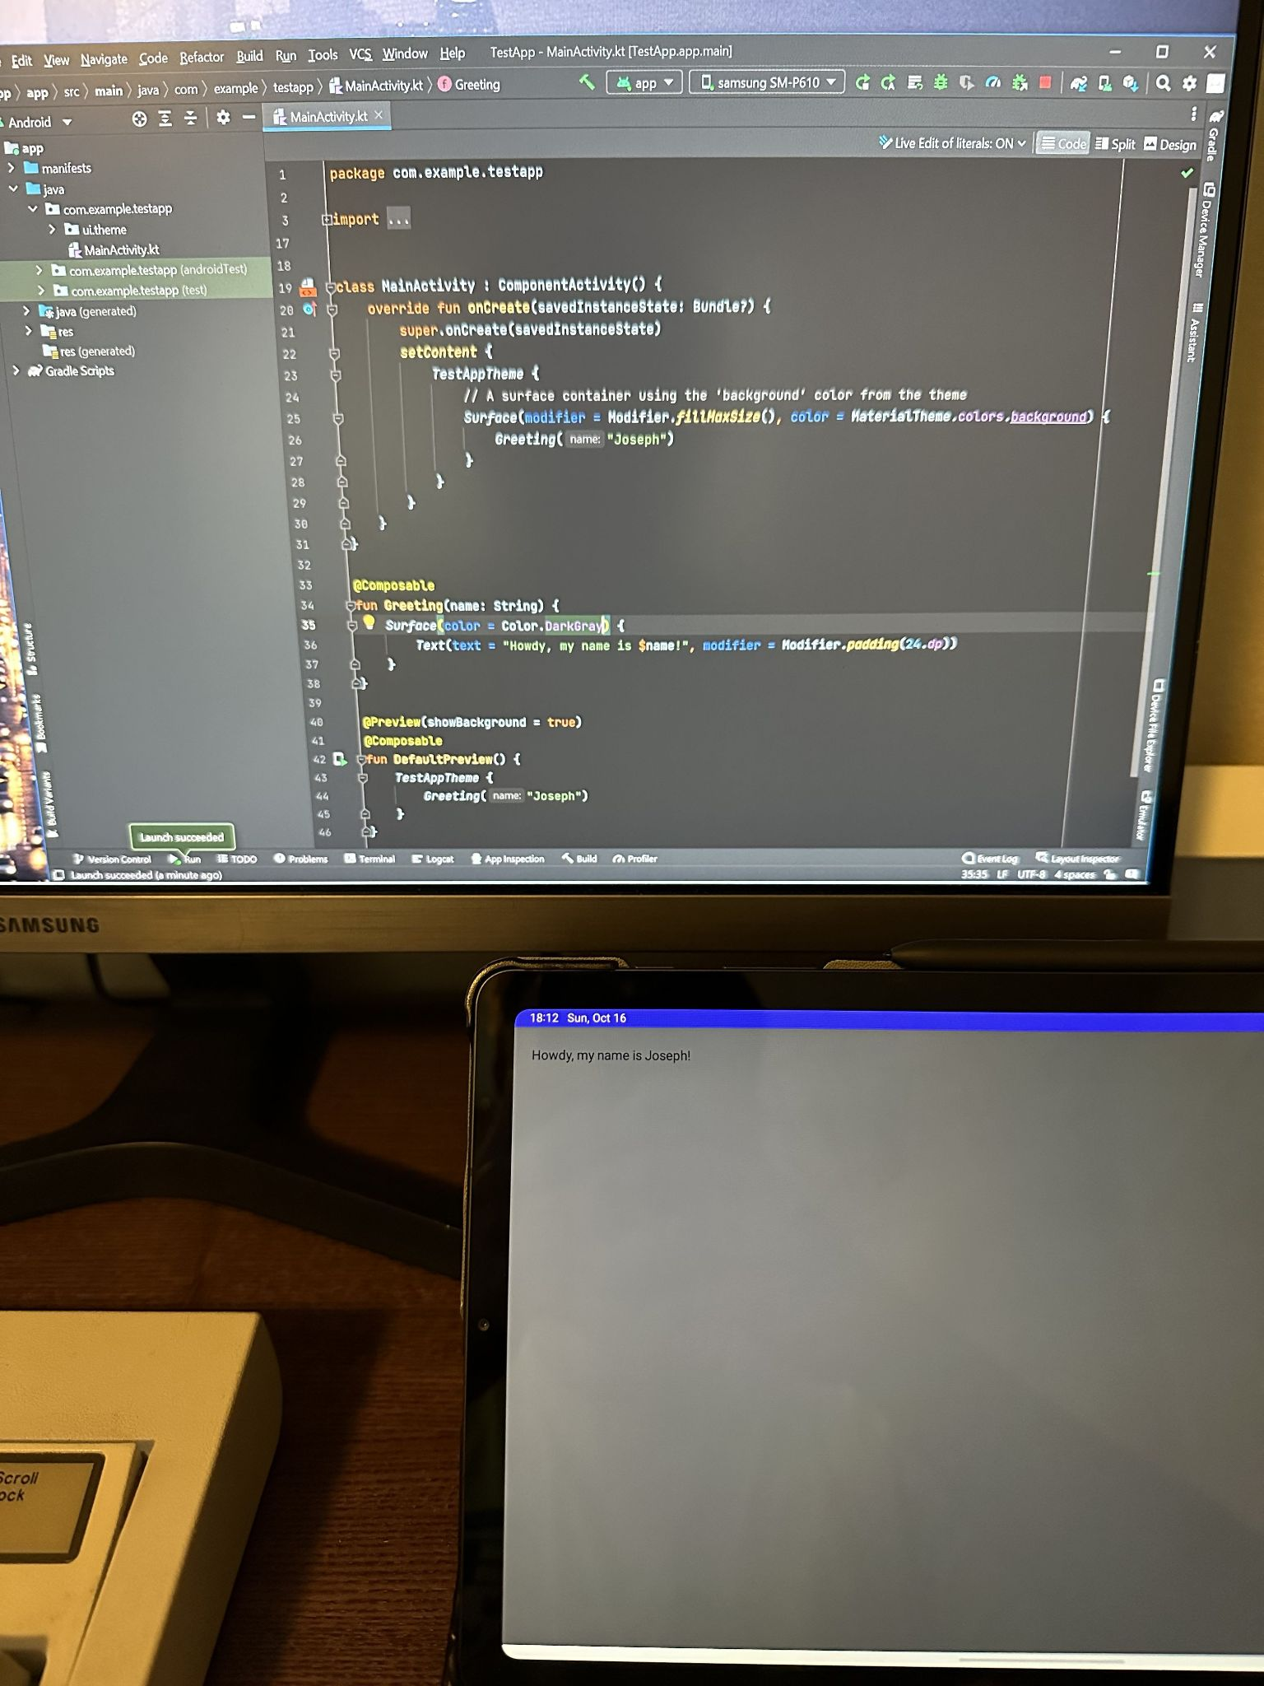
Android Application - Joseph
Design accomplishments so far
Basic familiarization with Kotlin Basic use of Android Studio Run a test app on both Android Studio and my device
Upcoming plans
Continue working on Kotlin tutorials Work on Bluetooth connectivity Begin building the actual app (with version control via Github)
Notes:
As per Google’s recommendations, I’ve been learning Kotlin, a programming language closely related to Java
I have no experience working with Java or anything like it, so it’s all a bit new to me
Fortunately, Google provides tutorials on the Android Developer website that I’ve been working through
I’ve also been getting familiar with Android Studio, the official IDE for creating Android apps
It includes an emulator that can simulate almost any version of Android, which will be useful for testing device compatibility
It also let me deploy a test app on my Samsung Galaxy Tab S6 Lite, which I’ll be using for the subsystem demonstration
Pretty neat to have something that actually runs on my own tablet
Going forward, I’ll need to learn more Kotlin to build the actual control app → more Kotlin tutorials
I also need to investigate what’ll be needed (both from the Android device’s side and the Raspberry Pi side) to establish the Bluetooth connection that I’ll be using to pass data back and forth
Once that’s done, I’ll start building the real thing
I’ve never used Github before, so it’ll take a bit of getting used to

Slide 7
Power Supply & Robotic Levers - Pace
Accomplished since last presentation
Finished learning Altium basics
Selected AC/DC converter; selected and designed DC/DC converters
Found suitable H-bridge IC
Goals to accomplish by the end of the month
Design components of PCB in Altium
Put all the PCB components together and route them
Design conveyor belt and robotic levers in cad
Notes:
TB6612FNG dual h-bridge

Slide 8
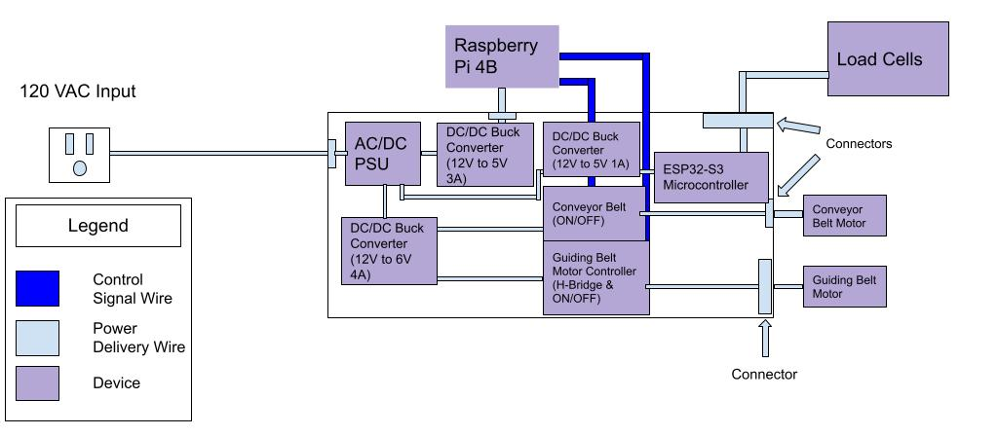
Power Supply & Robotic Levers - Pace
Updated Subsystem Block Diagram
Notes:
AC/DC converter, buck converters, microcontrollers and h-bridge all chosen (along with RLC values). Basics of altium learned, starting PCB design. ME component of design to be done by the end of the month.

Slide 9
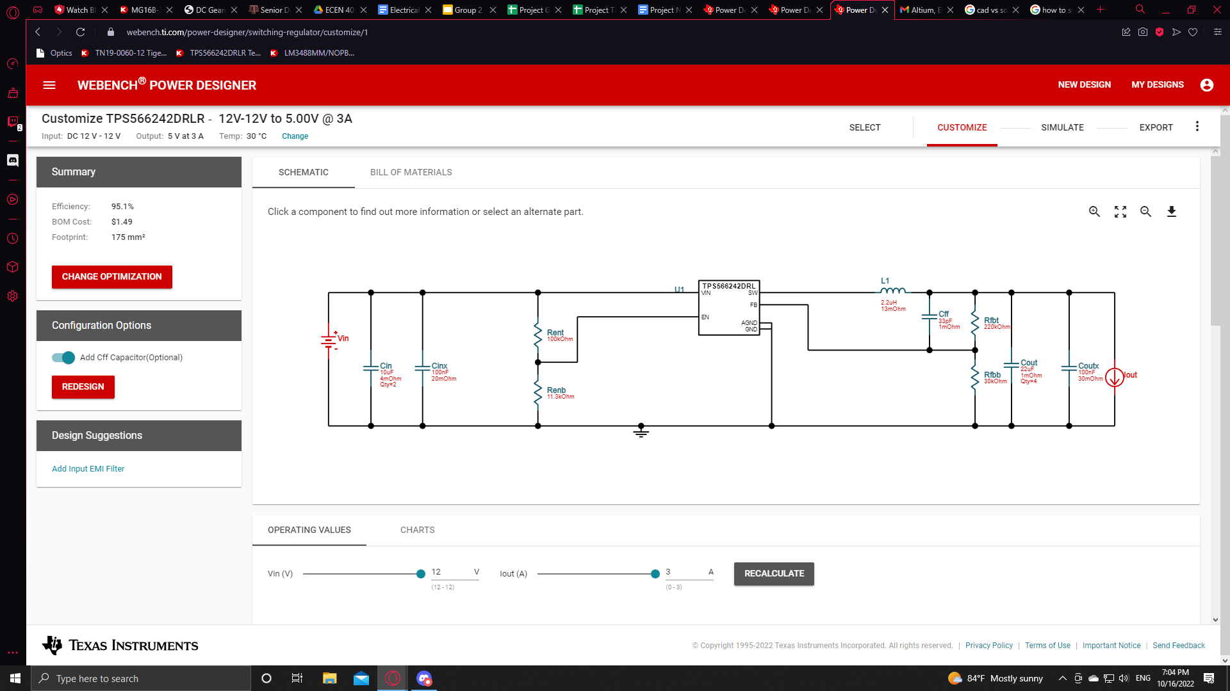
DC/DC Converter for Raspberry Pi 4B

Slide 10
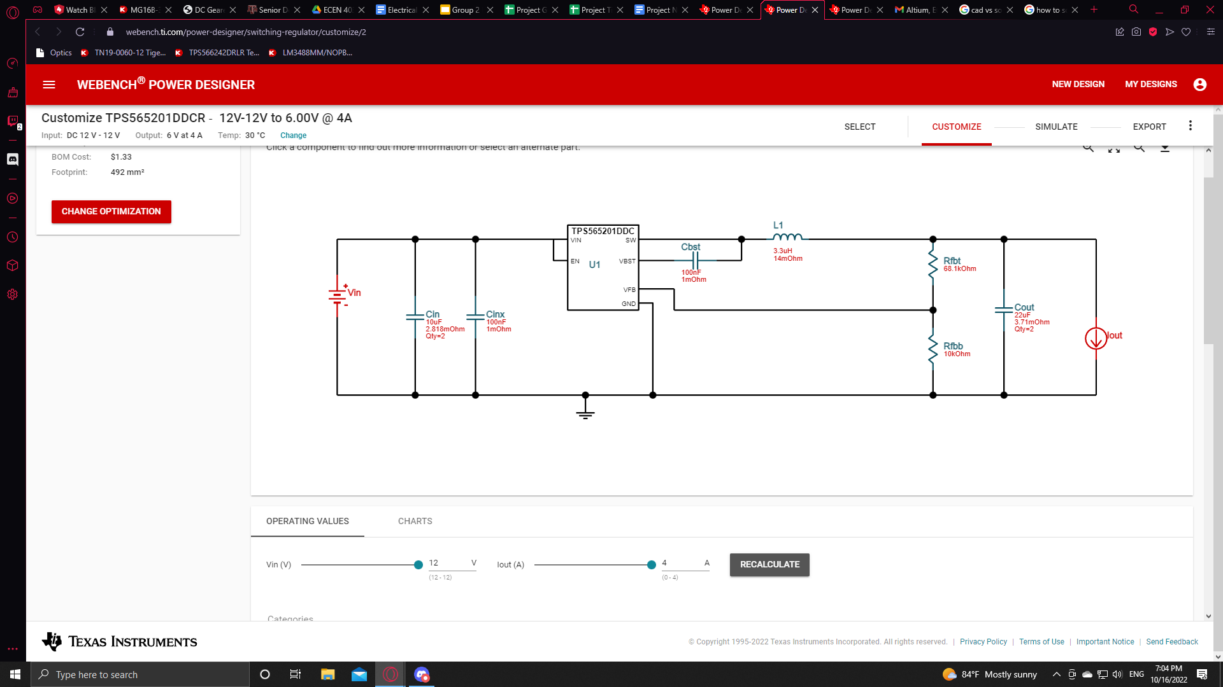
DC/DC Converter for Both Motors

Slide 11
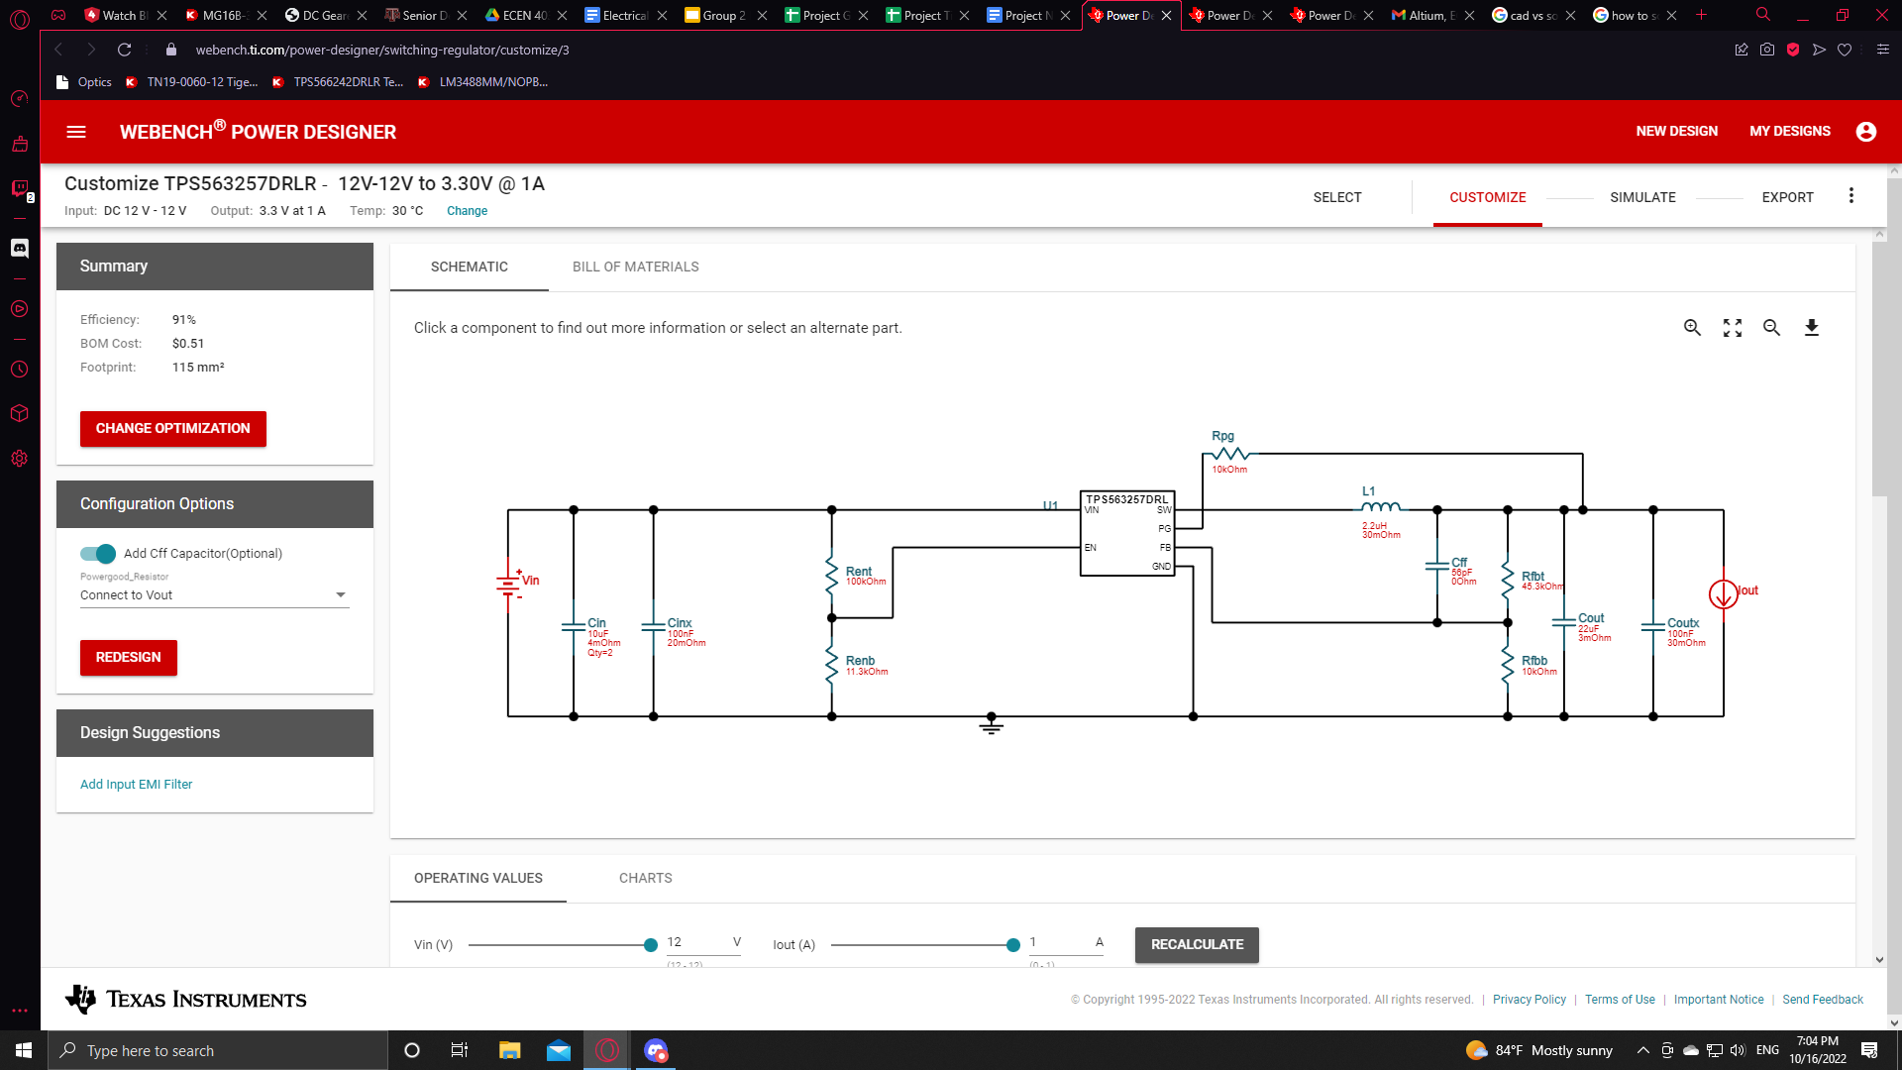
DC/DC Converter for Load Cell Microcontroller

Slide 12
Sensors - Lam
Accomplishments since the last presentation | Ongoing progress/problems and plans until the next presentation
The weight sensor will use a ESP32 microcontroller. Design and simulate wheatstone bridge and differential amplifier circuits. Learn OpenCV to process image and video. | Continue learning OpenCV Build the weight sensor Begin programing color algorithm

Slide 13
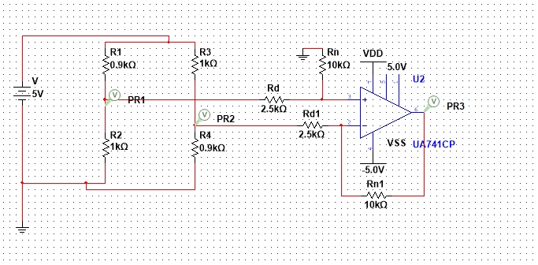
Wheatstone Bridge and Differential Amp

